Slide 1

YAANA
Course Code: 24CA3503
Course Title: Project Stage 1
Program: BCA
Semester: V
Section: ‘A’
Name: KRUPA LAXMI SV USN: SCA24CA0044

Slide 2
Index
Title of the Project
Introduction
Technologies and Tools/ Framework/ Dataset Used
Problem Statement
Objectives
Literature Survey
Proposed Methodology/Model
Architectural Design
DFD/ Flowcharts

Slide 3
Introduction
YAANA is an AI-Based Student Ride Matching System which is a full-stack platform that helps verified college students find travel partners moving on similar routes at similar times.
Uses AI/ML to rank suitable ride partners instead of listing random matches.
Compares route overlap, departure time, transport mode, detour distance and estimated cost savings.
Helps students reduce travel cost, coordinate rides safely and maintain trip history.
Designed as a verified student-to-student platform using React, Express, Supabase and Python ML.

Slide 4
Technologies / Tools / Framework / Dataset Used
Category | Technology
Frontend | React.js
Backend | Node.js with Express.js
Database | Supabase
Authentication | College email / ID based verification
AI/ML Component | Python + Scikit-learn
Matching Logic | Weighted scoring + future ML ranking
Route Data | Mapping and routing API
Realtime Communication | Socket.IO (Future)
Version Control | GitHub
Dataset | Custom student trip, route and match dataset in Supabase
AI/ML matching uses multiple trip features to calculate compatibility.
Initial model: weighted scoring and recommendation algorithm.
Future model options: KNN similarity, Logistic Regression or Decision Tree ranking.
Route and detour values are calculated using mapping/routing API data.
Dataset features:
Student ID, verified status, source, destination, departure time, mode, route distance, detour, estimated cost, match status and savings.
These features support compatibility scoring and future ML training.

Slide 5
Problem Statement
Many college students travel to campus on similar routes and timings, but they usually book separate autos or cabs because there is no verified platform to identify safe and suitable travel partners.
Students cannot easily find others travelling from nearby locations.
Manual coordination is difficult and may not consider route overlap or time difference.
Separate rides increase travel expenses and duplicate journeys.
The system must rank potential ride partners using route, time, detour, transport mode and cost-saving factors.
The platform should also protect student privacy and verify users through college identity.

Slide 6
Objectives
To develop a full-stack AI/ML-based student ride matching platform.
To verify students using college email/ID before allowing ride matching.
To allow students to create trips with source, destination, date, time and transport mode.
To compare route overlap, time compatibility, detour distance, transport mode and cost savings.
To rank the most suitable travel partners using an AI/ML recommendation component.
To enable match acceptance/rejection, communication and ride coordination.
To maintain trip history and estimated savings for future recommendations.
To provide admin management for users, trips and reports.

Slide 7
Literature Survey
Study / Technology | Key Idea | Relevance to Project
Ride-sharing Systems | Connect users travelling in similar directions or time windows. | Core concept for student-to-student travel partner discovery.
Recommender Systems | Rank suitable options using similarity, weights and user preference data. | Used to rank the best ride matches instead of random listing.
KNN Similarity | Finds nearby records based on selected numerical or encoded features. | Future ML model for route/time/transport-based match similarity.
Route Optimization APIs | Estimate distance, route overlap, detour and travel time. | Provides map-based features required for compatibility scoring.
Privacy-Aware Platforms | Protect sensitive information such as location, identity and contact details. | Important for safe verified college-student ride matching.

Slide 8
Proposed Methodology / Model
The proposed system uses a three-layer AI/ML-based matching approach:
Layer 1: Verification & Trip Data Capture
Student registers using college email/ID.
Profile stores home/start location and transport preference.
Student creates trip with source, destination, date, time and mode.
Layer 2: Feature Extraction & Scoring
System compares routes, destination, departure time and transport mode.
Mapping API estimates distance, detour and possible cost savings.
Weighted score calculates compatibility for every potential match.
Layer 3: AI/ML Ranking & Recommendation
Python + Scikit-learn ranks the most suitable matches.
Initial version uses weighted recommendation logic.
Future version can use KNN, Logistic Regression or Decision Tree ranking.

Slide 9
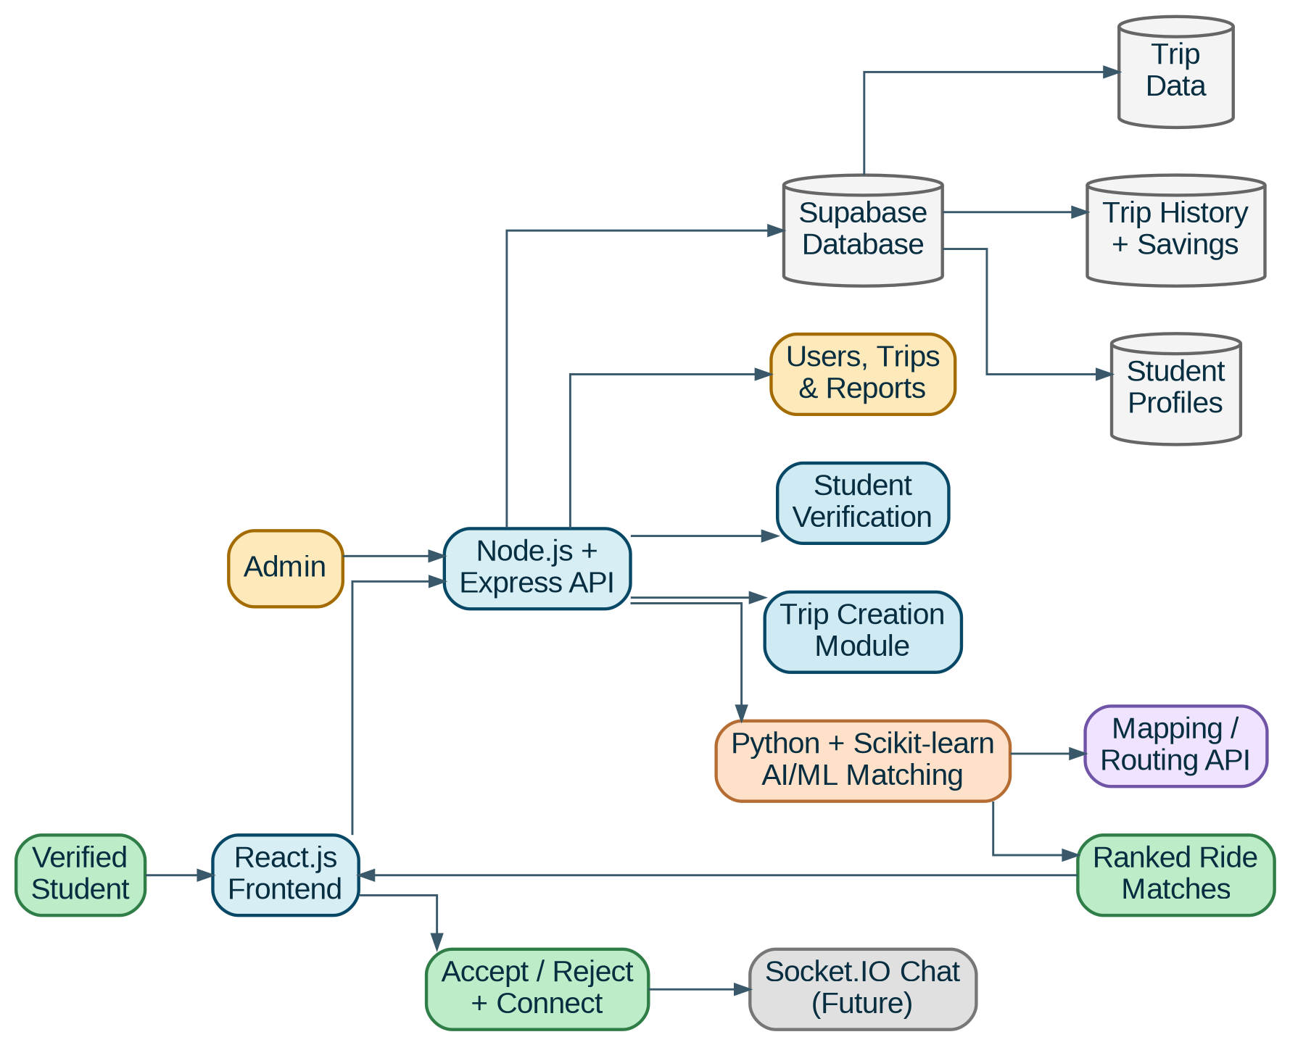
Architectural Design

Slide 10
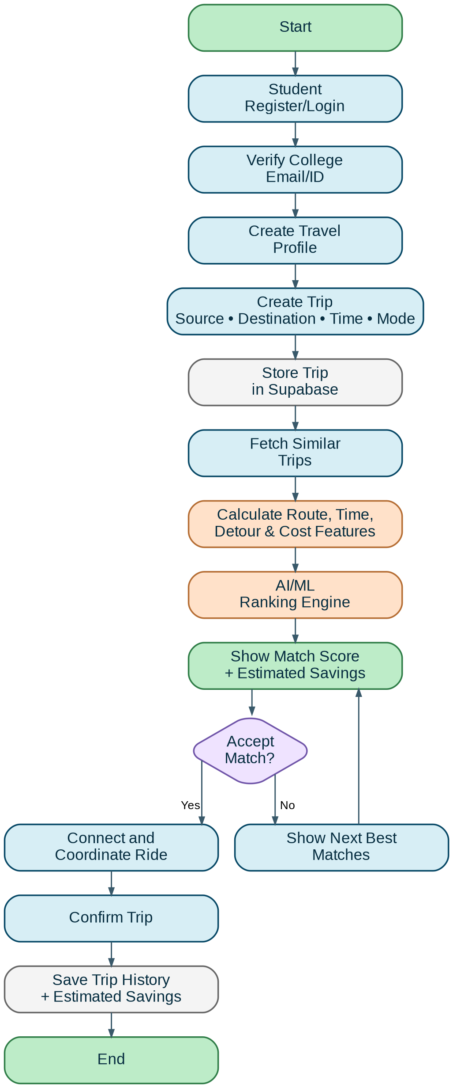
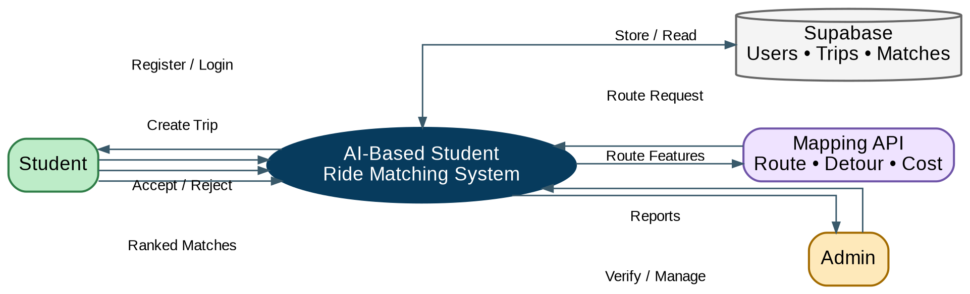
DFD / Flowchart
Detailed Flowchart
DFD Level 0

